Slide 1
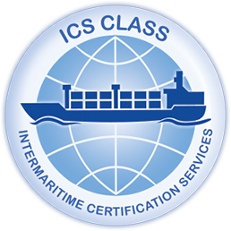
Reporting Procedures to the ICS Class Head Office

Slide 2
1. Supporting Documentation Requirements According to Annex 4, the attending Surveyor must submit specific documentation to the Operation Department for each type of survey or certification. Key Documents Include: Previous class and statutory certificates Relevant forms, records, and mandatory endorsements Note: If the previous certificates were issued by ICS Class, this requirement may be waived.
2. Additional Documentation Requests
During the verification process, the Marine Division may request further documentation deemed necessary to complete the assessment of the survey and certification

Slide 3
3. Submission Deadlines Advice for Completion of Survey: Must be submitted within 5 days of the survey's completion. Information Records: Must be submitted within 30 days post-survey completion.

Slide 4
4. Conditions for Issuance of Full-Term Certificates A full-term certificate will not be issued until the following conditions are met: The Operation Department has received all required information records as per Annex 4, including any additional requests from the Marine Division. Technical personnel from the Marine Division have fully reviewed and verified the results of the completed survey.

Slide 5
5. Processing of Information Records All records submitted by attending Surveyors related to technical supervision, classification, and statutory certification must be: Received Processed Verified Controlled Preserved This will be done in accordance with Procedure PA02-P01 for the planning and operational control of services
Conclusion Proper adherence to these reporting procedures ensures compliance and the integrity of the certification process. Thank you for your attention, and let’s open the floor for any questions.

